Slide 1
AGM 2019
CEO Report
Steve Crone
Introduction to the RMBF

Slide 2
Helping doctors and their families for over 180 years.
Every year the RMBF helps hundreds of doctors, medical students and their family members who are in serious hardship due to illness, injury, disability, ageing or bereavement.

Slide 3
How we help

Slide 4
We provide
Financial support to doctors of all specialties and at all stages of their careers due to age, ill health, disability, or bereavement
Grants for medical students in financial difficulty due to ill health, disability or bereavement

Slide 5
Types of support
Regular monthly grants
Back to work awards
Medical student grants
Refugee doctor grants
Money advice
PhoneFriends

Slide 6
Headline figures, 2018-19
300 beneficiaries received support
£553,914 expended in grants and loans
124,000 visits to our online support services
86 medical students received money advice
£804,731
total financial impact on our beneficiaries

Slide 7
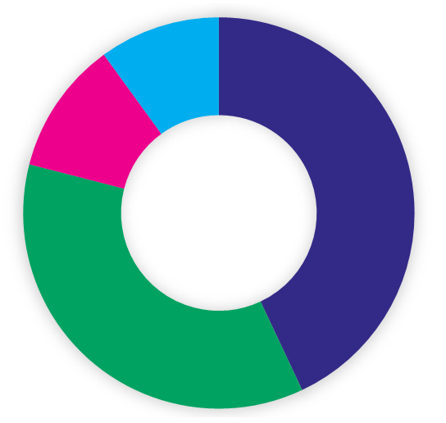
Why people turn to the RMBF, 2018-19
Mental illness
43%
Physical illness
36%
Refugee doctors
11%
Carer/age/bereavement
10%

Slide 8
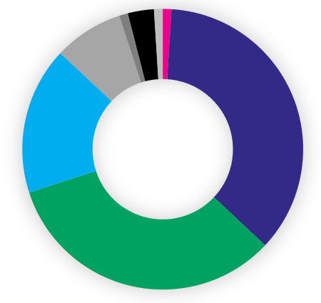
Age of new applicants to the RMBF, 2018-19
0-20 years 1%
21-30 years 36%
31-40 years 33%
41-50 years 17%
51-60 years 8%
61-70 years 1%
71-80 years 3%
81-90 years 1%

Slide 9
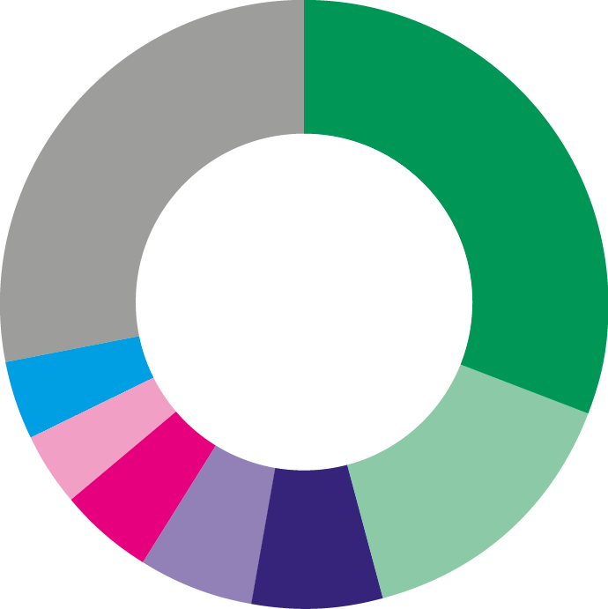
Specialties of beneficiaries, 2018-19
GP/GP trainee 31%
Psychiatry 15%
Paediatrics 7%
Surgery 6%
Emergency medicine 5%
Anaesthesia 4%
Ophthalmology 4%
Others 31%
Includes other specialties and foundation year/junior doctors

Slide 10
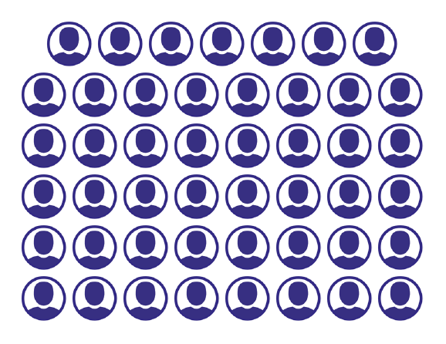
Back to work support
47 beneficiaries helped to return to work or remain in employment
32 beneficiaries given help towards education and training

Slide 11
Expanding
support

Slide 12
Coach Mentoring
Supporting doctors back to work following period of ill health
Highly skilled RMBF volunteer network & accredited training in partnership with OCM
First cohort of five volunteer Coach Mentors now qualified
11 beneficiaries benefited from Coach Mentoring in 2019

Slide 13
DocHealth
Confidential psychotherapy for doctors, supported by the BMA and the RMBF
557 doctors have self-referred to the service
83% presented with high or very high risk of burnout, 52% with significant depression, and 85% with significant anxiety
92% would recommend the service to others

Slide 14
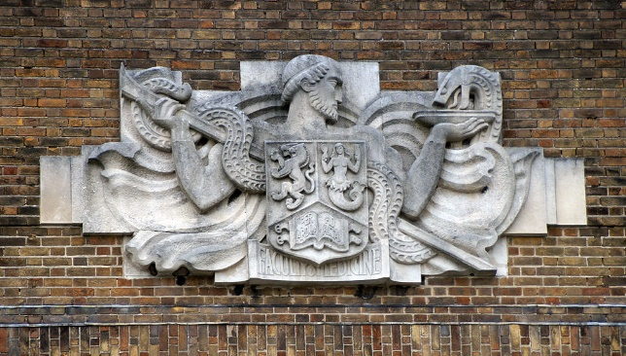
Medical Student Programme
More than 50 students helped with essential living costs since programme launched
Recruited over 25 Student MLOs – new volunteer role to spread word of our support in medical schools nationwide
Regular meetings of Medical Student Advisory Group, continuing to inform and guide our work

Slide 15
What our beneficiaries say
“Words cannot express how grateful I am for your support during the worst year of our lives.”
“You have been a miracle to me and my young kids. I don't know how we would have managed through this difficult time without you all.”
“It has been a terrible 2 years. I am so grateful for your support. I honestly don't know how I would have survived without it.”

Slide 16
What our beneficiaries say
“I am incredibly grateful for the help the RMBF gave me at a horrible time of my life with the breakdown of my marriage when my daughter was just two...
“I don’t like to think about the consequences we might have faced if we hadn’t had the security and solace of our own home.”

Slide 17
Thank you

Slide 18
The RMBF relies on voluntary donations. Without the support of the medical profession we could not continue to provide vital support to doctors, medical students and their families.
www.rmbf.org
twitter.com/theRMBF
facebook.com/theRMBF
instagram.com/theRMBF
24 Kings Road, Wimbledon, London SW19 8QN
Registered with the Charity Commission for England and Wales No 207275. Registered with the Scottish Charity Regulator No SC046148. A company limited by guarantee, registered in England No 00139113.

